Slide 1


Exception Handling
Unexpected event occurring during runtime that stops or disturbs the program.

Slide 2
Exception Hierarchy
BaseException
├── BaseExceptionGroup
├── GeneratorExit
├── KeyboardInterrupt
├── SystemExit
└── Exception
├── ArithmeticError
├── AssertionError
├── AttributeError
├── BufferError
├── EOFError
├── ExceptionGroup
├── ImportError
├── LookupError
├── MemoryError
├── NameError
├── OSError
├── ReferenceError
├── RuntimeError
├── StopAsyncIteration
├── StopIteration
├── SyntaxError
├── SystemError
├── TypeError
├── ValueError
└── Warning
├── ArithmeticError
├── FloatingPointError
├── OverflowError
└── ZeroDivisionError
├── OSError
├── BlockingIOError
├── ChildProcessError
├── ConnectionError
│ ├── BrokenPipeError
│ ├── ConnectionAbortedError
│ ├── ConnectionRefusedError
│ └── ConnectionResetError
├── FileExistsError
├── FileNotFoundError
├── InterruptedError
├── IsADirectoryError
├── NotADirectoryError
├── PermissionError
├── ProcessLookupError
└── TimeoutError
├── ValueError
└── UnicodeError
├── UnicodeDecodeError
├── UnicodeEncodeError
└── UnicodeTranslateError
├── ImportError
└── ModuleNotFoundError
└── Warning
├── BytesWarning
├── DeprecationWarning
├── EncodingWarning
├── FutureWarning
├── ImportWarning
├── PendingDeprecationWarning
├── ResourceWarning
├── RuntimeWarning
├── SyntaxWarning
├── UnicodeWarning
└── UserWarning
├── LookupError
├── IndexError
└── KeyError
├── NameError
└── UnboundLocalError
├── RuntimeError
├── NotImplementedError
└── RecursionError
├── SyntaxError
└── IndentationError
└── TabError

Slide 3
Exception Handling
Every Exception in Python is Object
Python Virtual Machine (PVM) will throw an Exception Object
Remaining part of the program wont get executed after throwing Exception Object
Keywords: try, except, finally
Try – Exception occurring possible area
Except – Exception Handling area
Finally – Clean up code, will be executed always
Else – Only when no exception occurs
Hierarchy of exception: except should place last
Using as keyword to display the error name
Multiple exceptions given in single except
try
Exception occurs
No Exception occurs
except
else
finally

Slide 4
Exception Handling
There are two kind of errors: Syntax error and Exceptions
Syntax Error
Any errors made on the structure of the program
Otherwise called as Parse error
Exception
an exception is an event that disrupts the normal flow of the program
Even if a statement or expression is syntactically correct, it may cause an error when an attempt is made to execute it.
Example:
while True print('Hello world')
^
SyntaxError: invalid syntax
Example:
15/0
ZeroDivisionError: division by zero

Slide 5
Try and Except Statement
The try clause contains the code that can raise an exception, while the except clause contains the code lines that handle the exception
Syntax:
try:
Statement
except <exception Type>:
Statement
Example:
while True:
try:
x = int(input("Please enter a number: "))
break
except ValueError:
print("Not a valid Number")

Slide 6
finally keyword
The finally keyword is always used after the try-except block.
The finally code block is always executed after the try block has terminated normally or after the try block has terminated for some other reason.
Syntax:
try:
Statement
except <exception Type>:
Statement
finally:
Statement
Example:
try:
div = 10 / 0
print( div )
except ZeroDivisionError:
print( “Divide by zero" )
finally:
print( 'This is finally clause' )

Slide 7
Raise Exception
The raise keyword is used for identifying the exception.
Example:
class MyError(Exception):
def __init__(self, value):
self.value = value
def __str__(self):
return (repr(self.value))
try:
raise (MyError(3 * 2))
except MyError as error:
print('A New Exception occurred: ', error.value)
Example:
x = 100
try:
if x > 100:
raise Exception("Sorry, no numbers below zero")
x = "Interruption"
if not type(x) is int:
raise TypeError("Only integers are allowed")

Slide 8
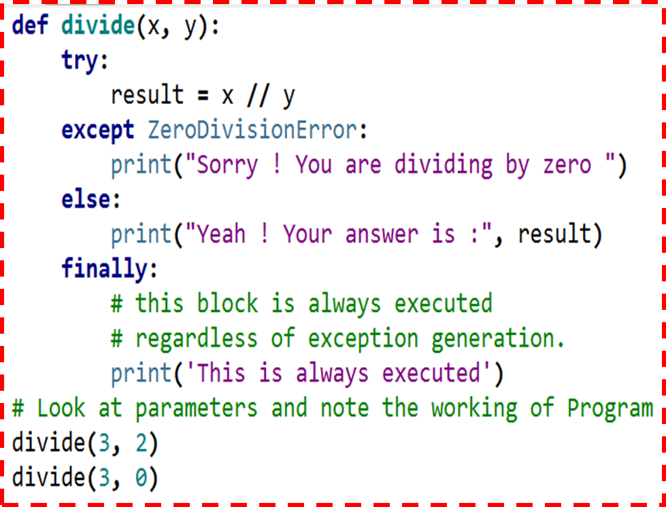
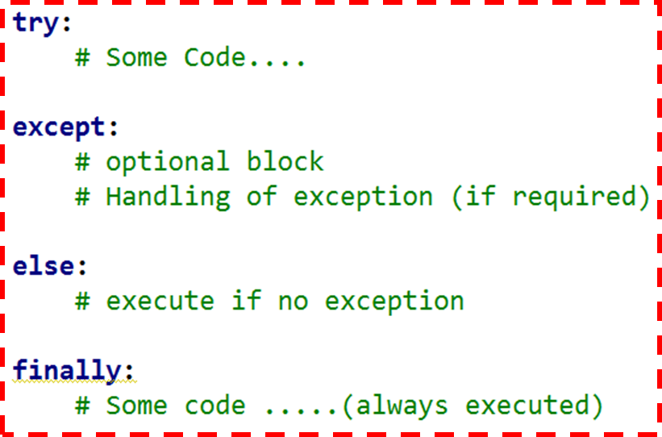
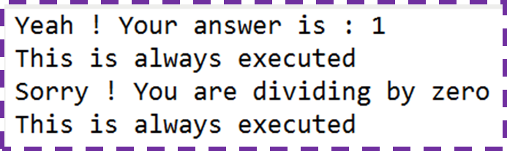

Slide 9
File Handling
Syntax
Directory Management
Open, Read, Write & Close a file
Delete a file
Delete Folder

Slide 10
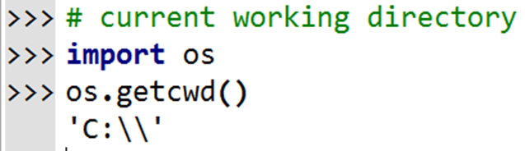
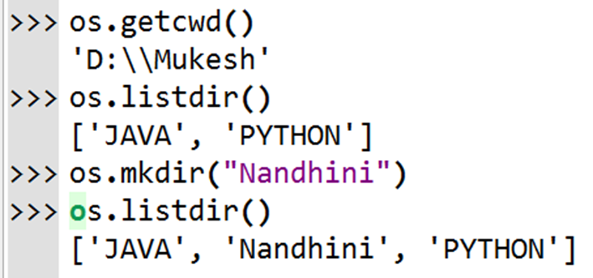
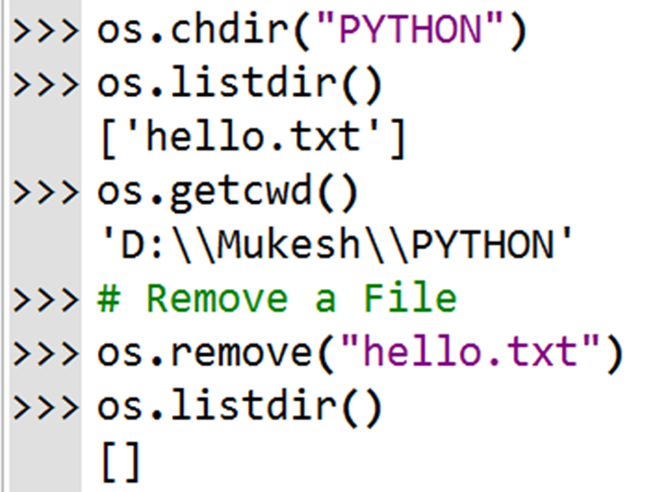
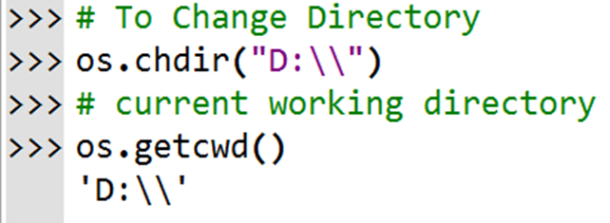
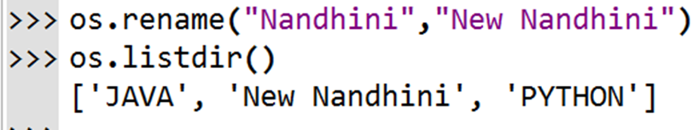
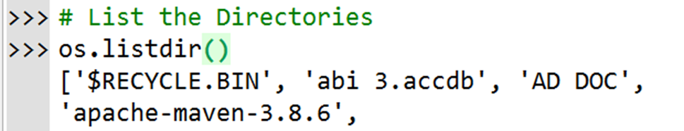
Directory Management

Slide 11
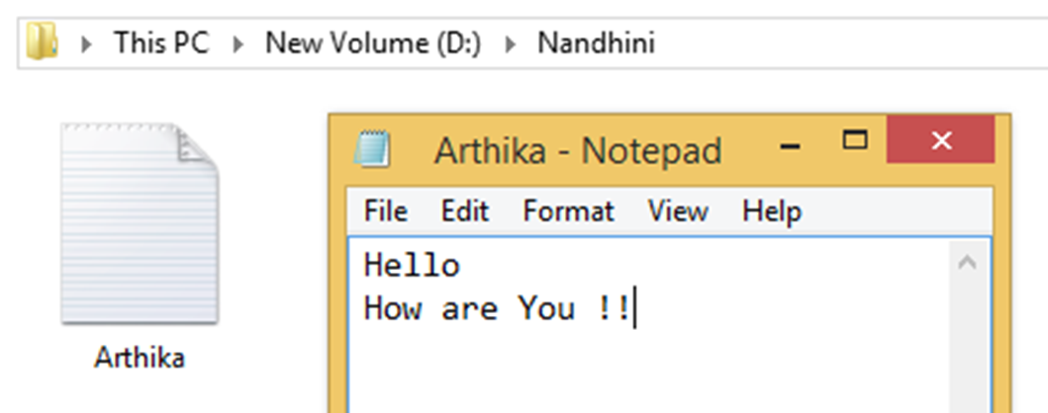
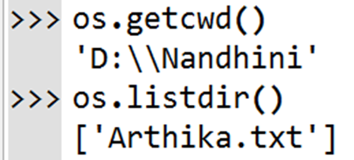
Files Management (Opening a File)

Slide 12
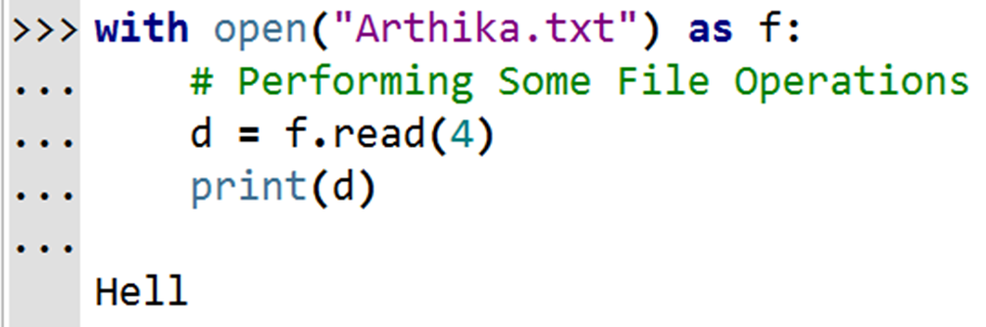
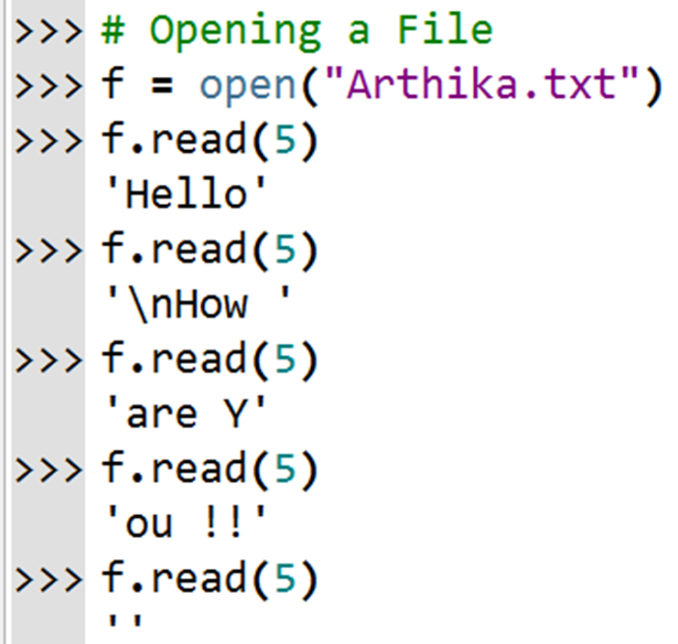
Reading a File using “With” Block

Slide 13
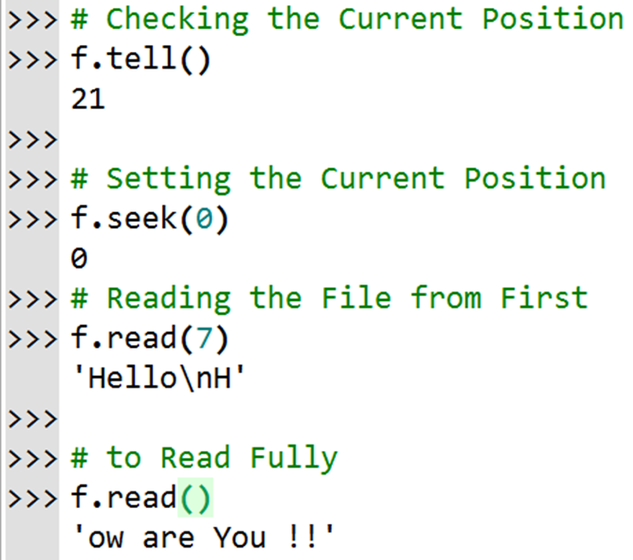
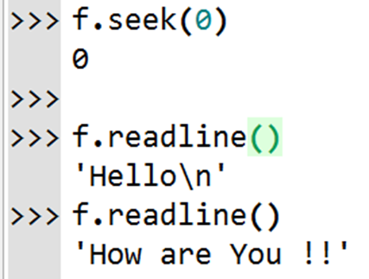
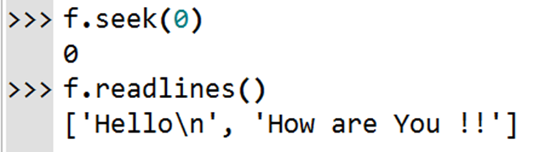
Seek( ), Tell( ), Readline[s]( )

Slide 14
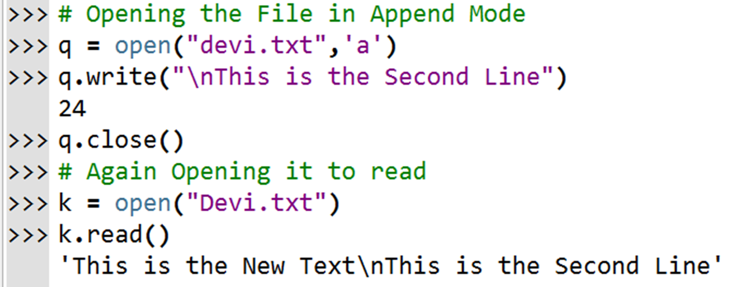
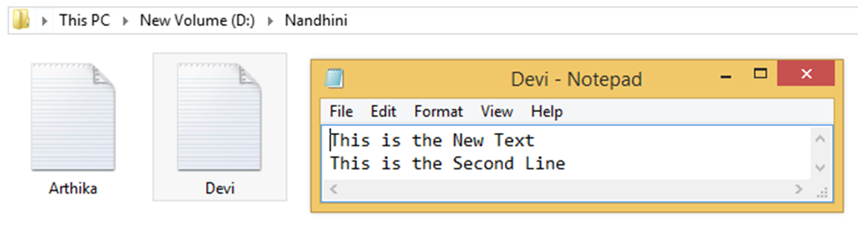
Appending

